Slide 1
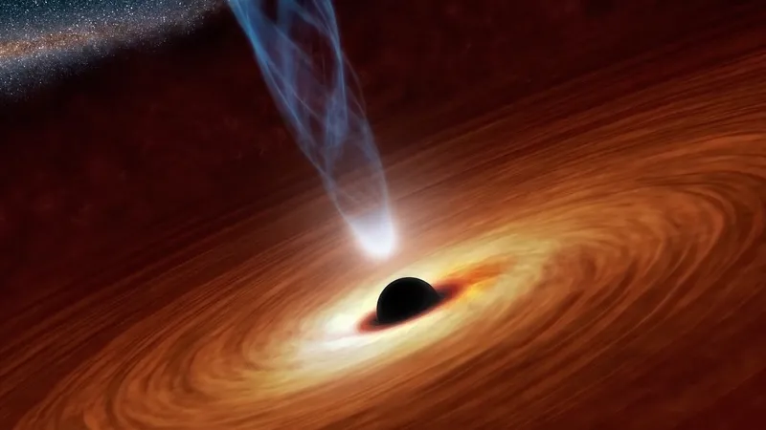
PHYS 129L Final Project Active Galactic Nuclei (AGN) Host Galaxy Simulation and Spectra Modeling
Annabella Yang*
University of California, Santa Barbara

Slide 2
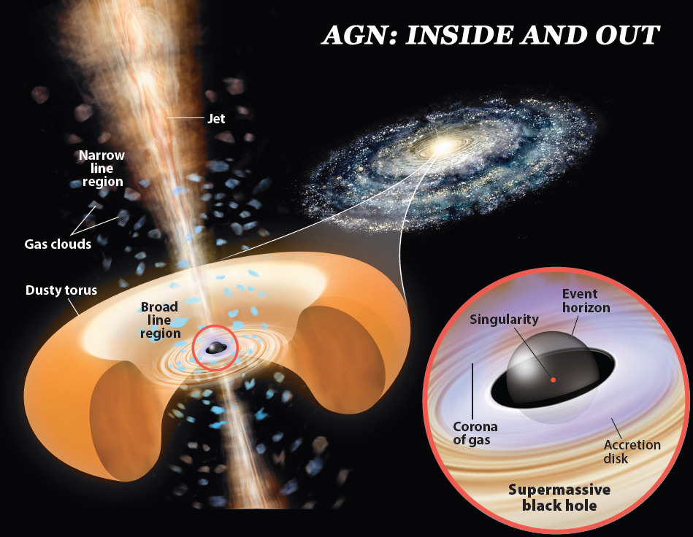
Introduction: AGN GALAXY
An AGN is a compact region at the center of a galaxy that emits a significant amount of energy across the electromagnetic spectrum
It is special because the luminosity is not produced by stars
A galaxy hosting AGN is called an active galaxy
These galaxies have incredible amount of energy

Slide 3
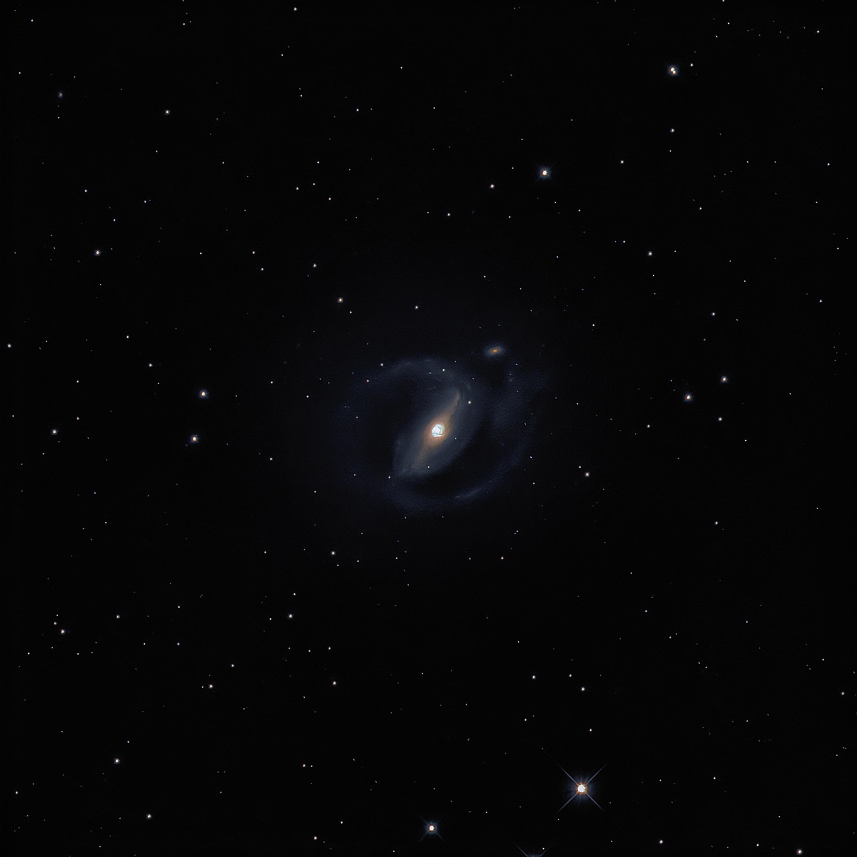
Introduction: Why Study AGN GALAXY?
Super massive blackholes
History of Universe
How Blackhole evolves over time
Environmental impact of clusters and galaxies
NGC1097

Slide 4
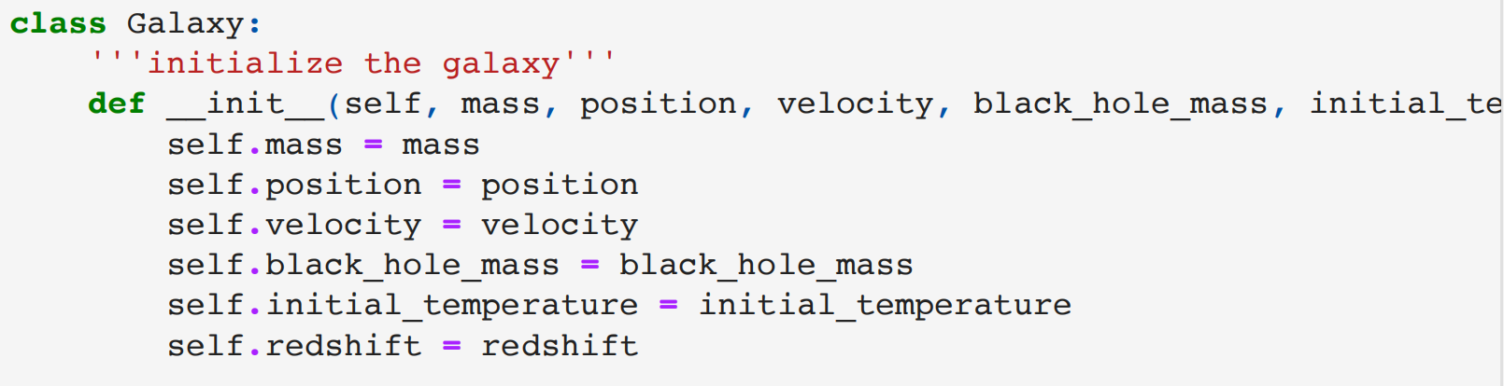
Goal for This Project
1, “Galaxy” Class
- Blackhole Accretion Model (Accretion Rate, Radiation, and Jet Production)
- Cooling and Heating Process (Cooling Rate, Heating Rate, and Temperature-time Evolution)
- Generating Spectrum (With Emission feature and noise)
2, Spectra Modeling
- Generate an AGN using the galaxy class I defined
- Fit the spectra using optimization
- Compare important parameters to observe any correlation
3, look at some implication
Some Useful Computational Methods in this Project:
Optimization: Used to fit the AGN galaxies
Monte Carlo Simulation: Used to find the correlation

Slide 5
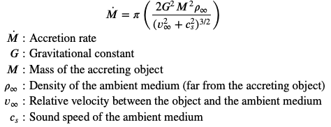
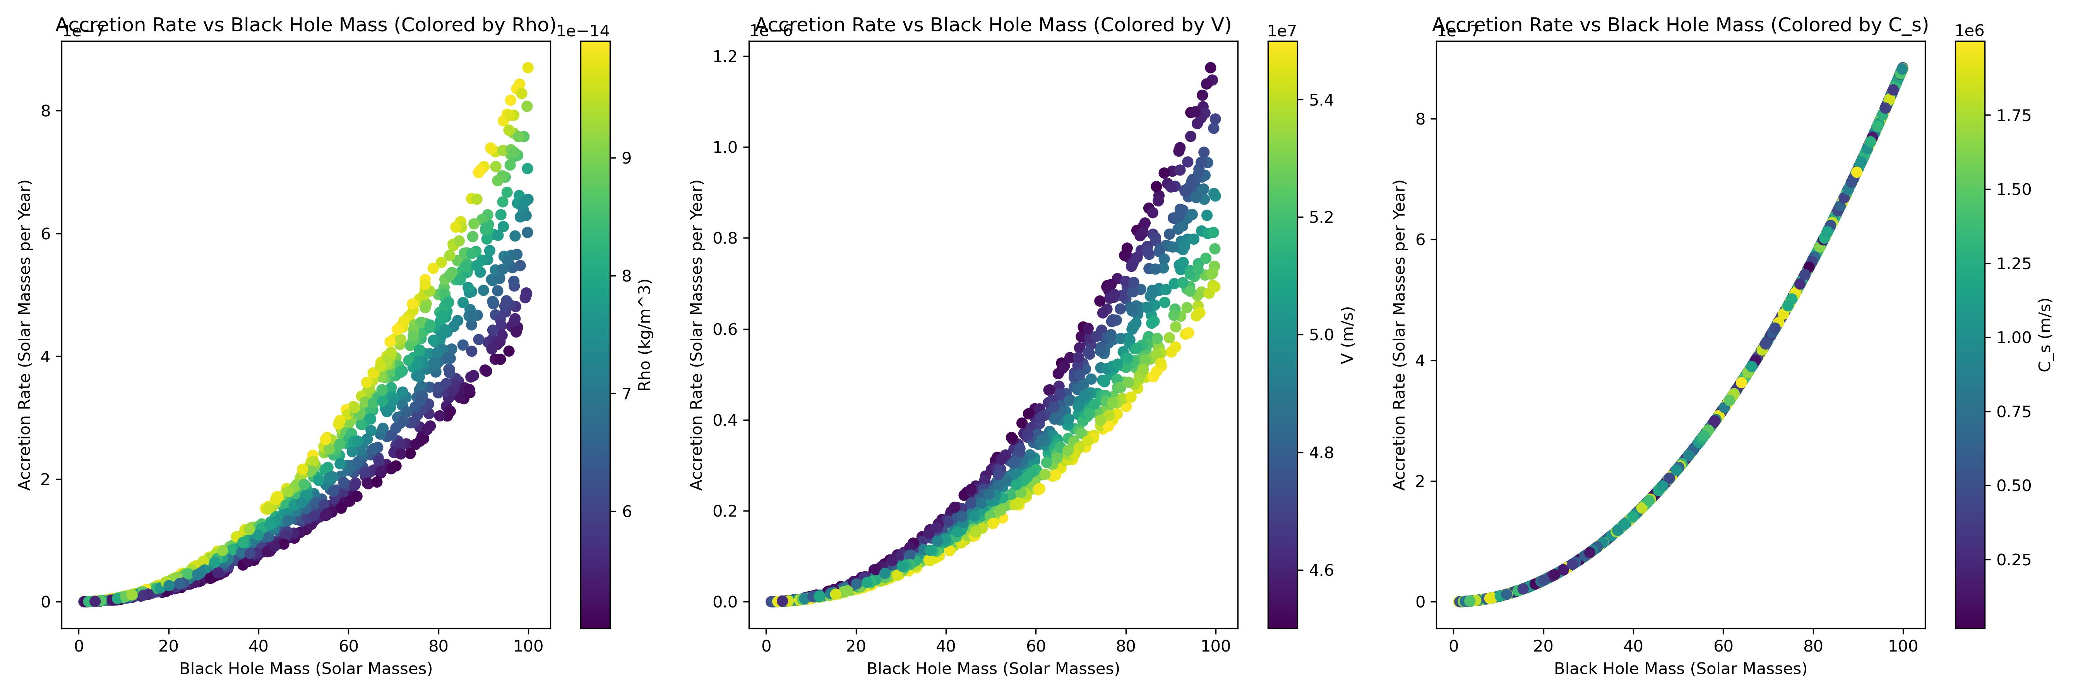

1st Model: Black Hole Accretion Model
Fixed Range:
$ρε[5e−14, 1e−13]$
$$vε[4.5e7, 5.5e7]$$
$$c_{s}ε[1e4, 2e6]$$
Bondi-Hoyle-Lyttleton accretion rate model

Slide 6
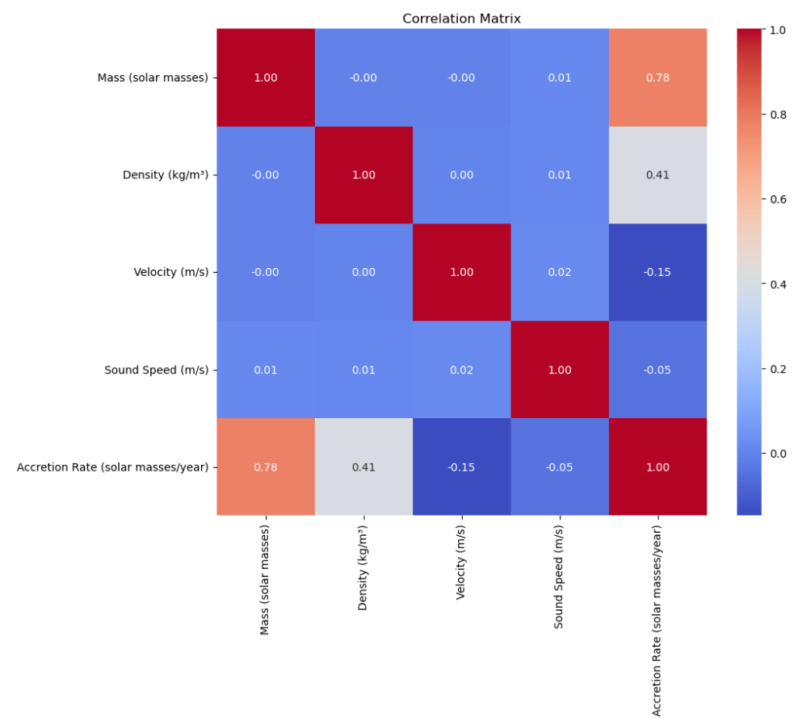
1st Model: Black Hole Accretion Model

Slide 7
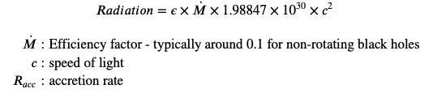
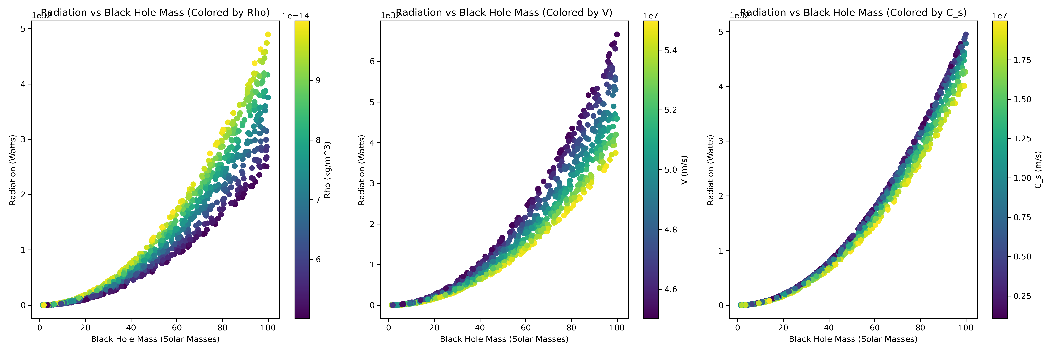
1st Model: Black Hole Accretion Model

Slide 8
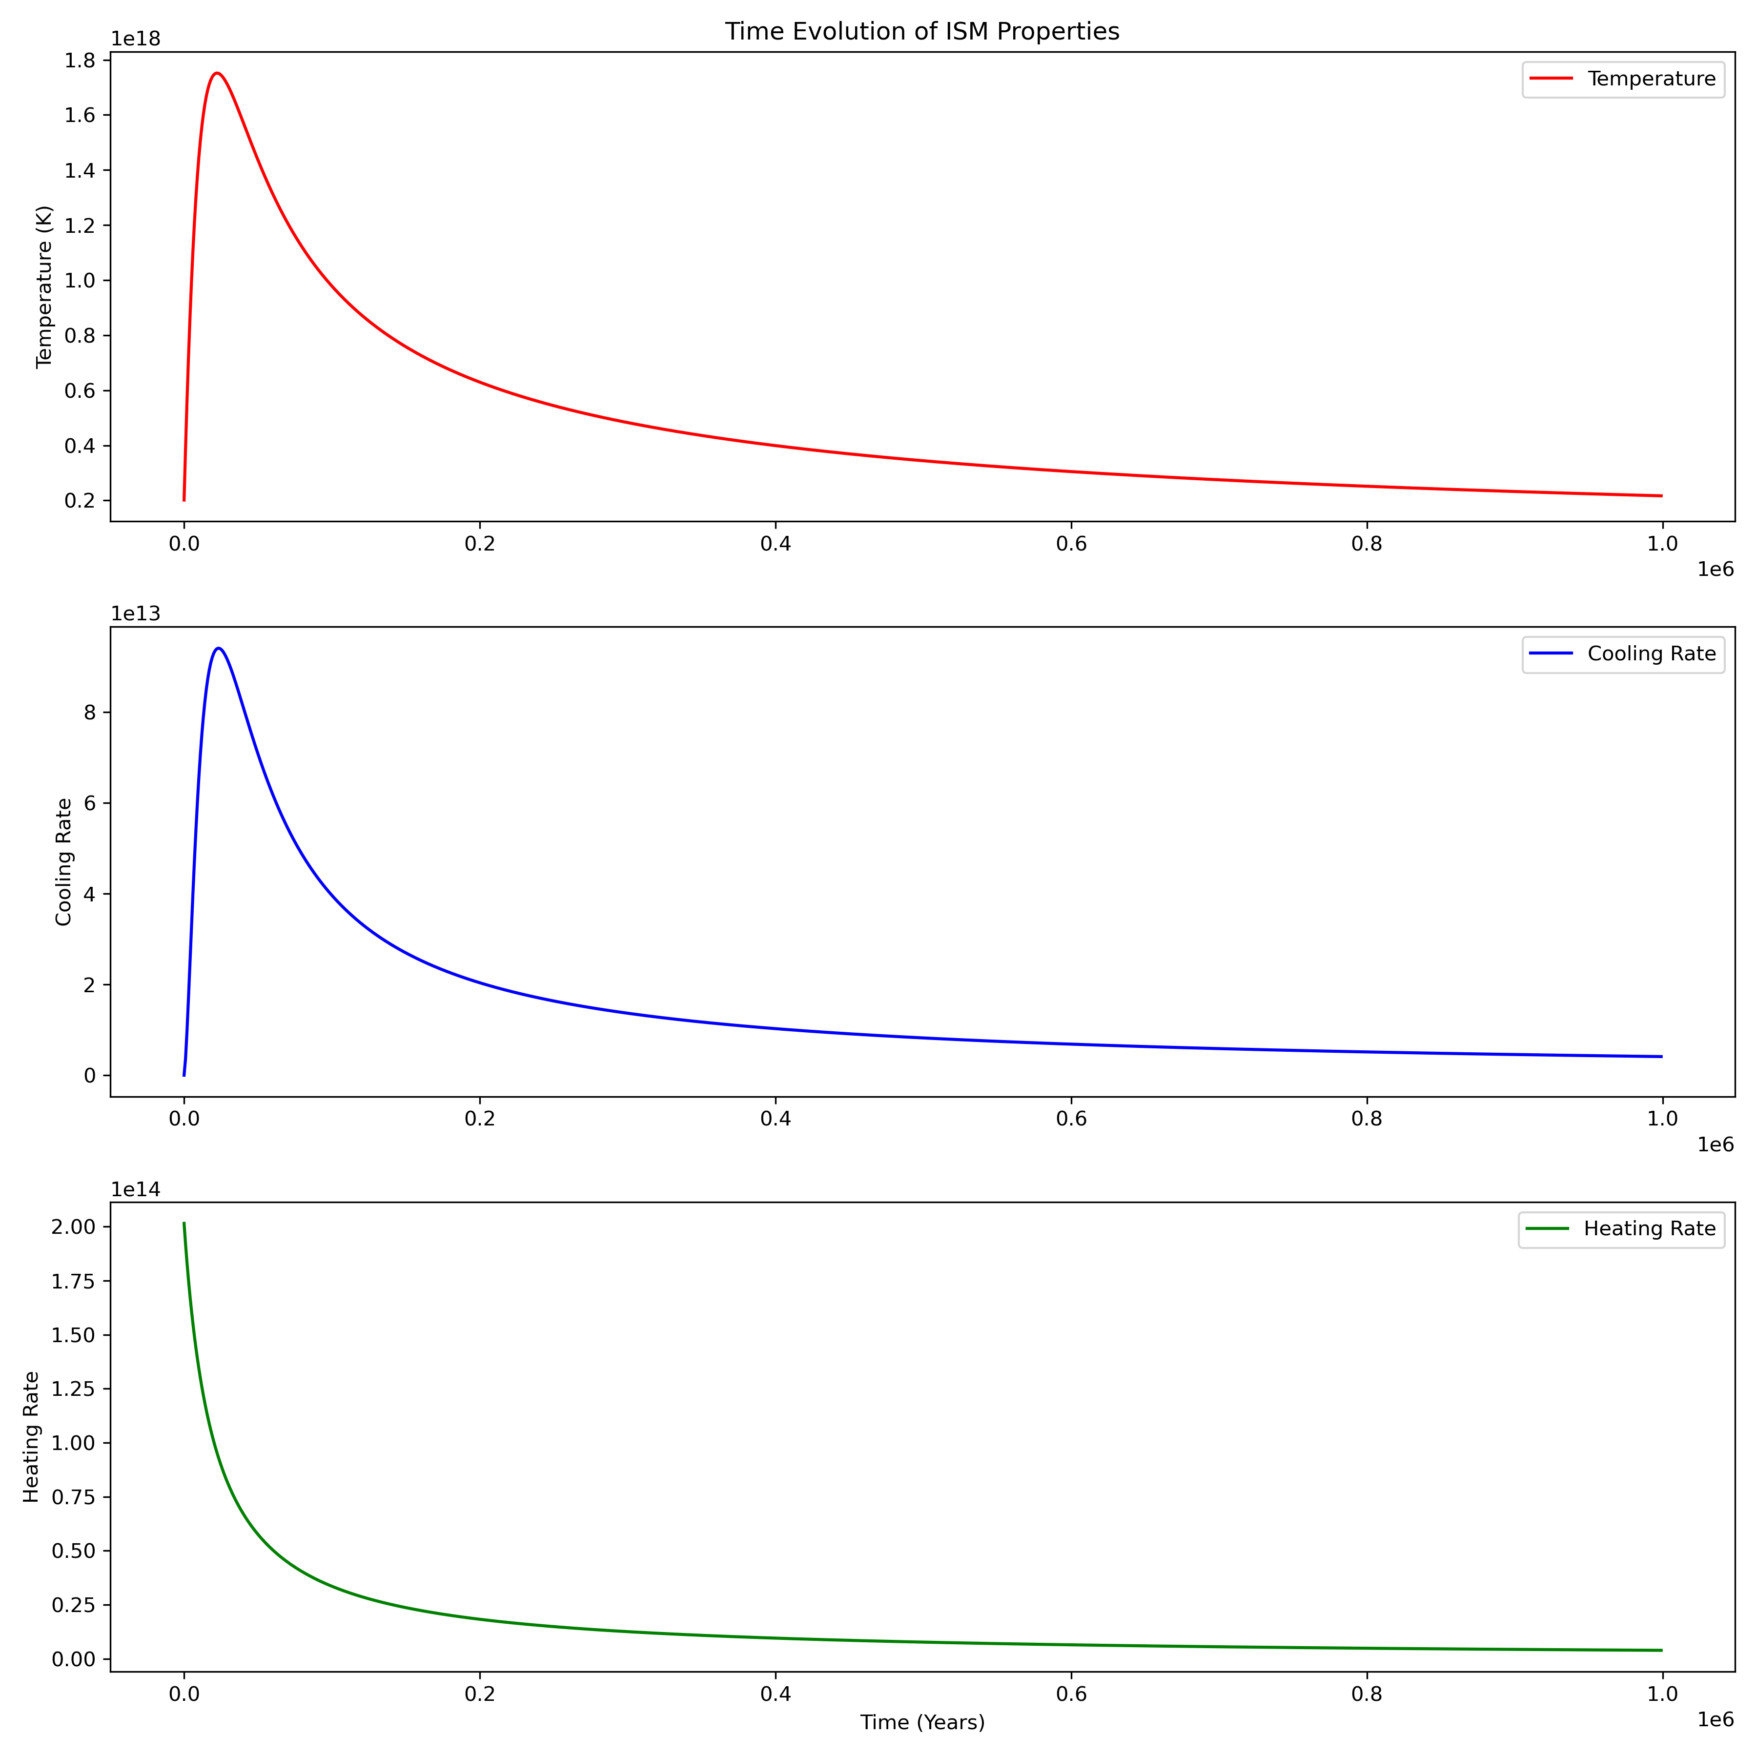
2nd Model: Cooling and Heating Model
Cooling rate:
low/high temperature regime
proportional to density^2
heatig rate:
decay factor that display a decay over time
proportional to star formation rate
proportional to luminosity
proportional to density
temperature:
calculated by
(heating rate - cooling rate)xtimestep

Slide 9
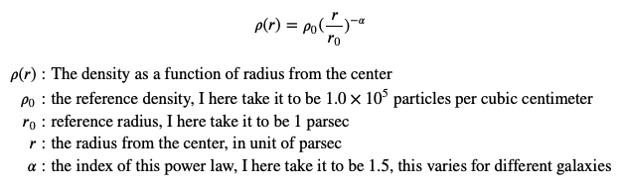
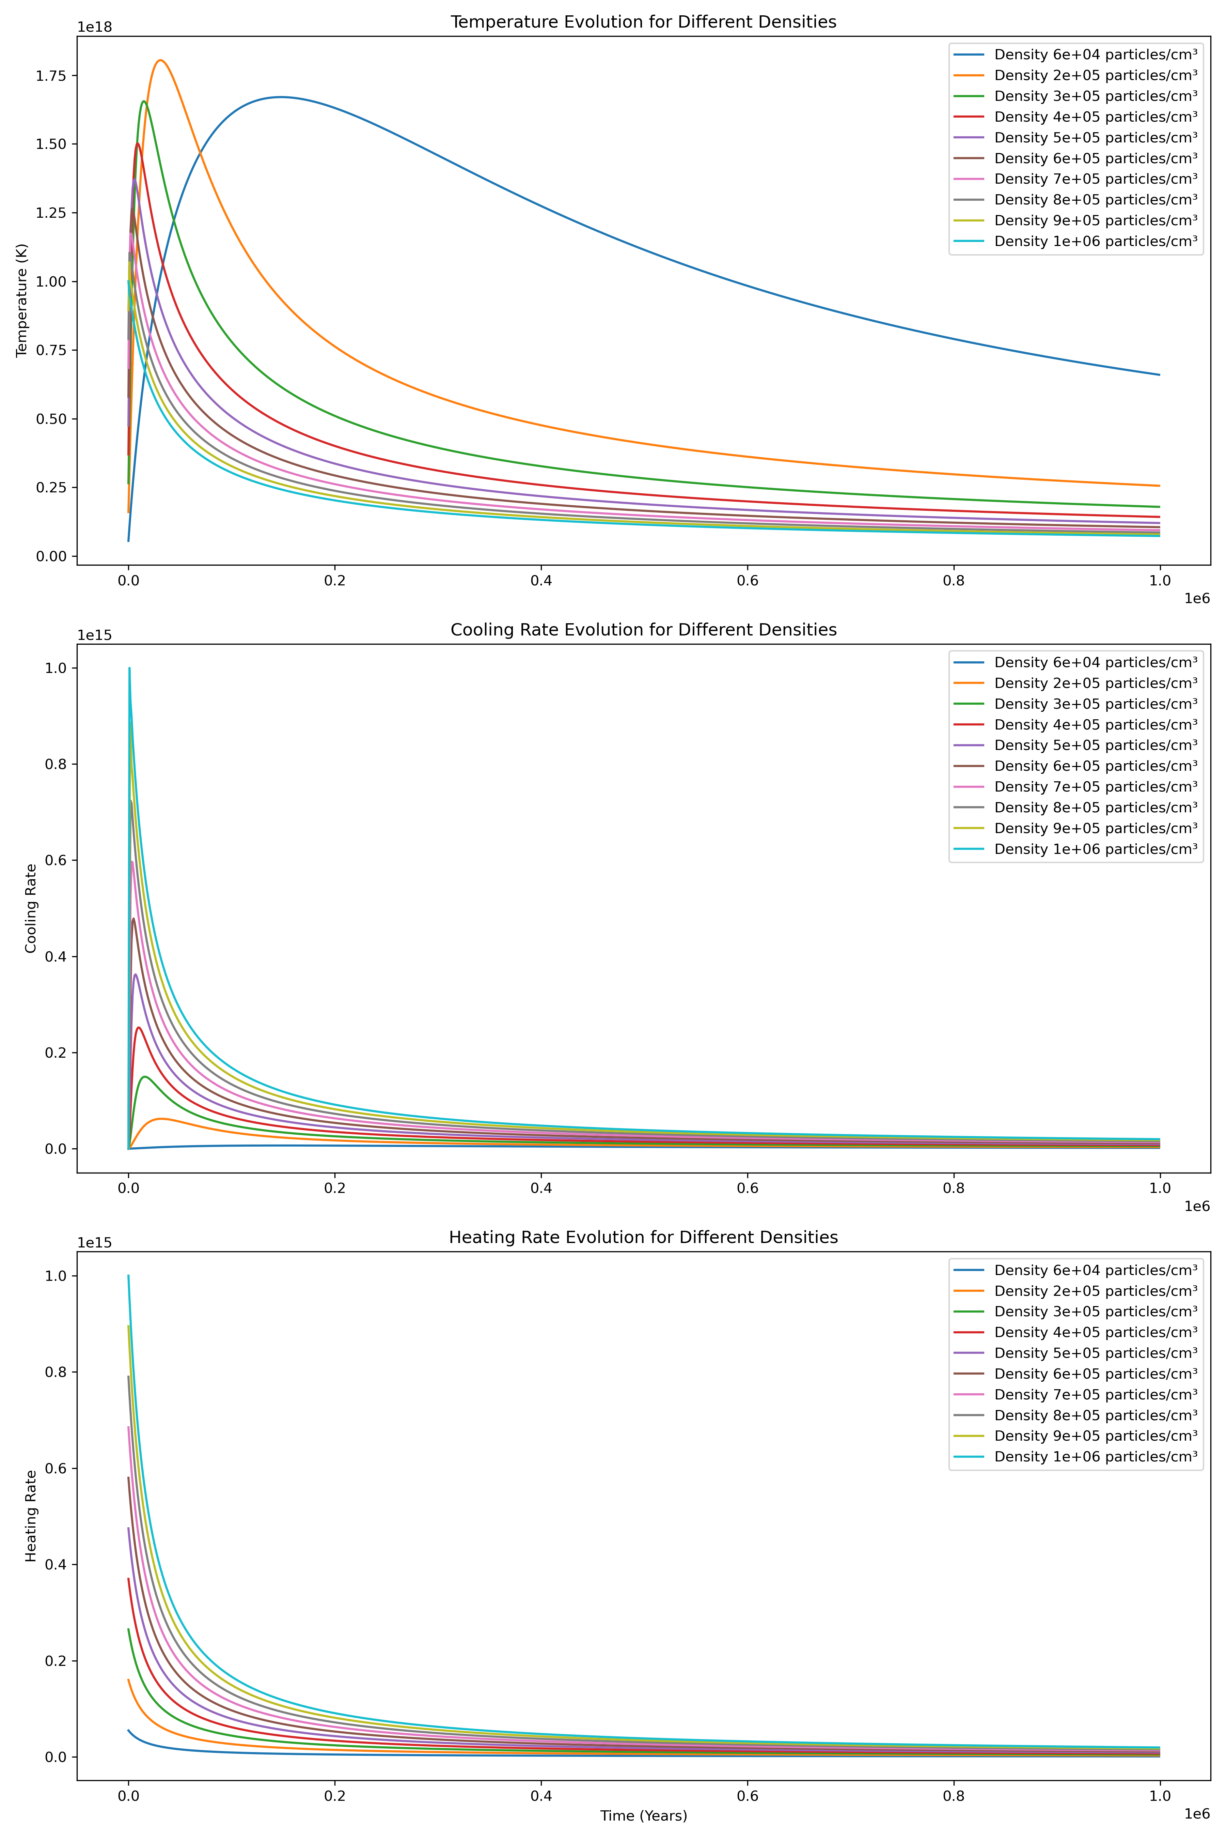
2nd Model: Cooling and Heating Model
As density increases, the heating rate increases, the cooling rate increases as well, and the overall temperature peaks lower and decays faster.
In the center of an AGN galaxy, the density is extremely high, and as the radius goes out, density decreases.
Thus, towards the center of an AGN galaxy, the temperature peaks higher and decays slower
Combining with our previous model, this makes sense.

Slide 10
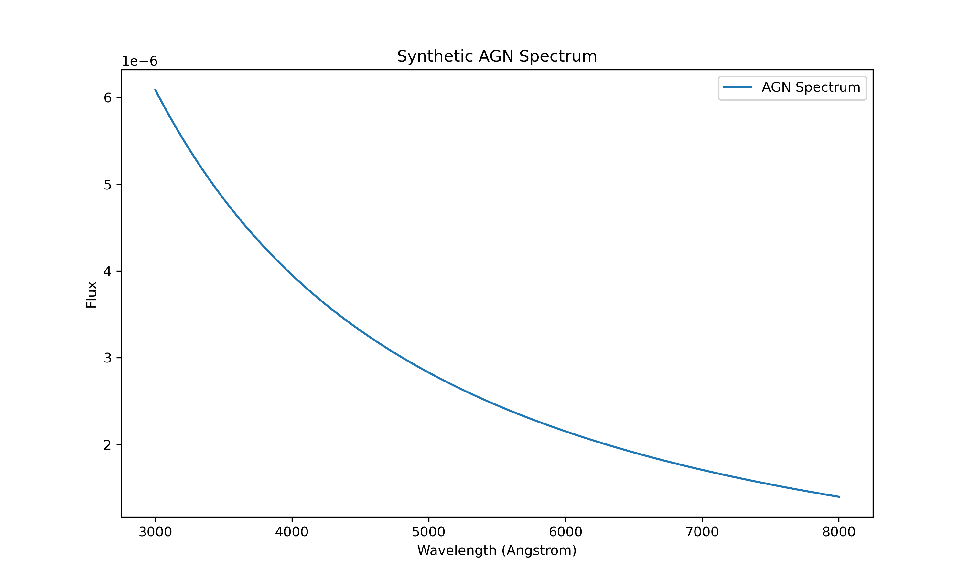
3rd Model: Generating a Spectra for AGN galaxy
1, Generate a power-law continuum
Emission lines:
H_alpha 6563Angstrom
H_beta 4861Angstrom
OIII_5007 5007Angstrom
OIII_4959 4959 Angstrom
NII_6584 6584 Angstrom
SII_6716 6716Angstrom
SII_6731 6731Angstrom

Slide 11
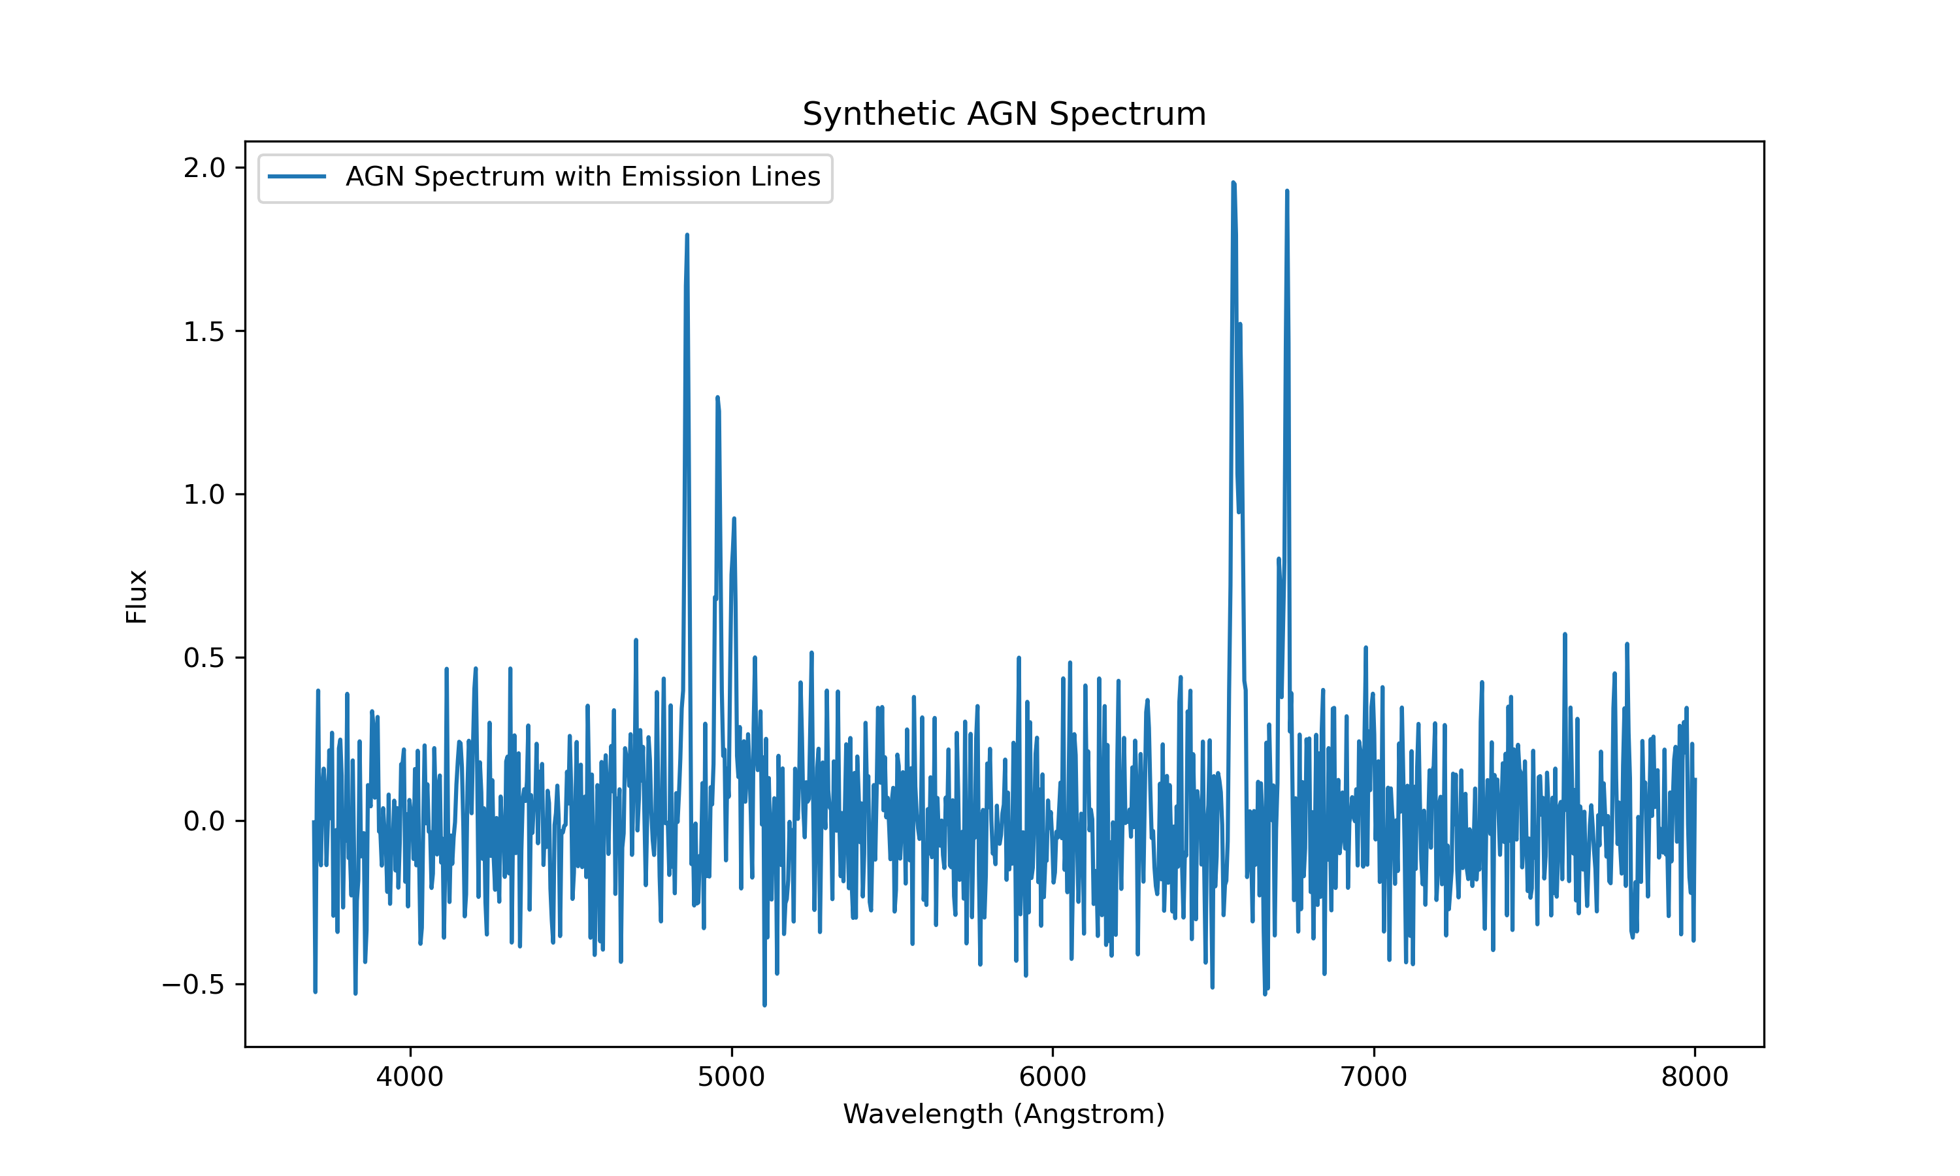
3rd Model: Generating a Spectra for AGN galaxy
1, Generate a power-law continuum
2, Consider emission lines
3, Add noise
Emission lines:
H_alpha 6563Angstrom
H_beta 4861Angstrom
OIII_5007 5007Angstrom
OIII_4959 4959 Angstrom
NII_6584 6584 Angstrom
SII_6716 6716Angstrom
SII_6731 6731Angstrom

Slide 12
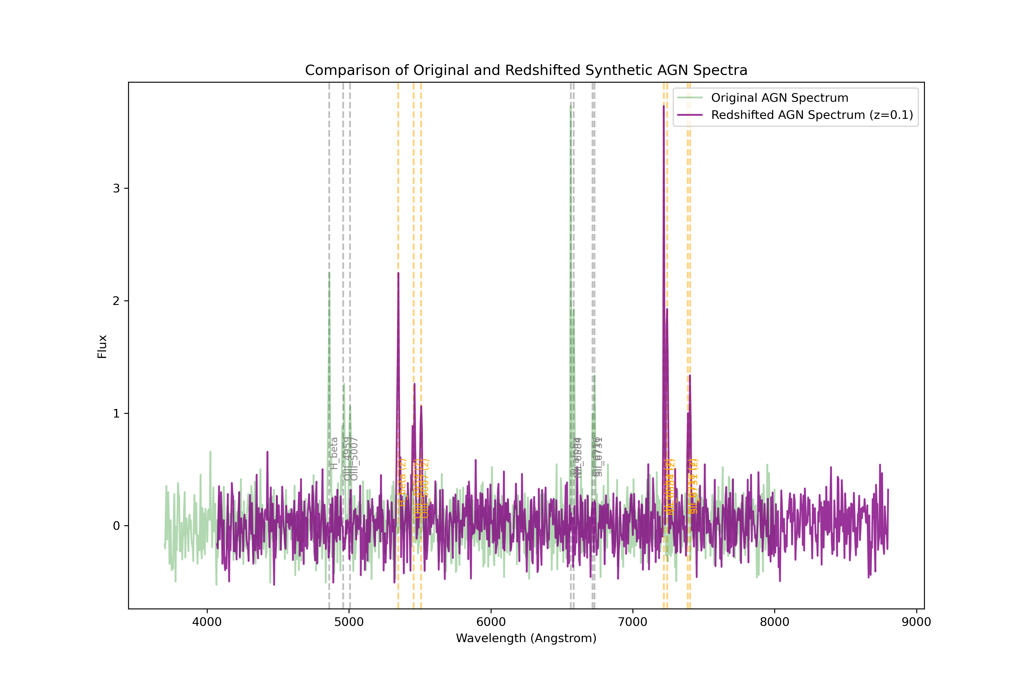
3rd Model: Generating a Spectra for AGN galaxy
1, Generate a power-law continuum
2, Consider emission lines
3, Add noise
4, Redshift
Emission lines:
H_alpha 6563Angstrom
H_beta 4861Angstrom
OIII_5007 5007Angstrom
OIII_4959 4959 Angstrom
NII_6584 6584 Angstrom
SII_6716 6716Angstrom
SII_6731 6731Angstrom

Slide 13
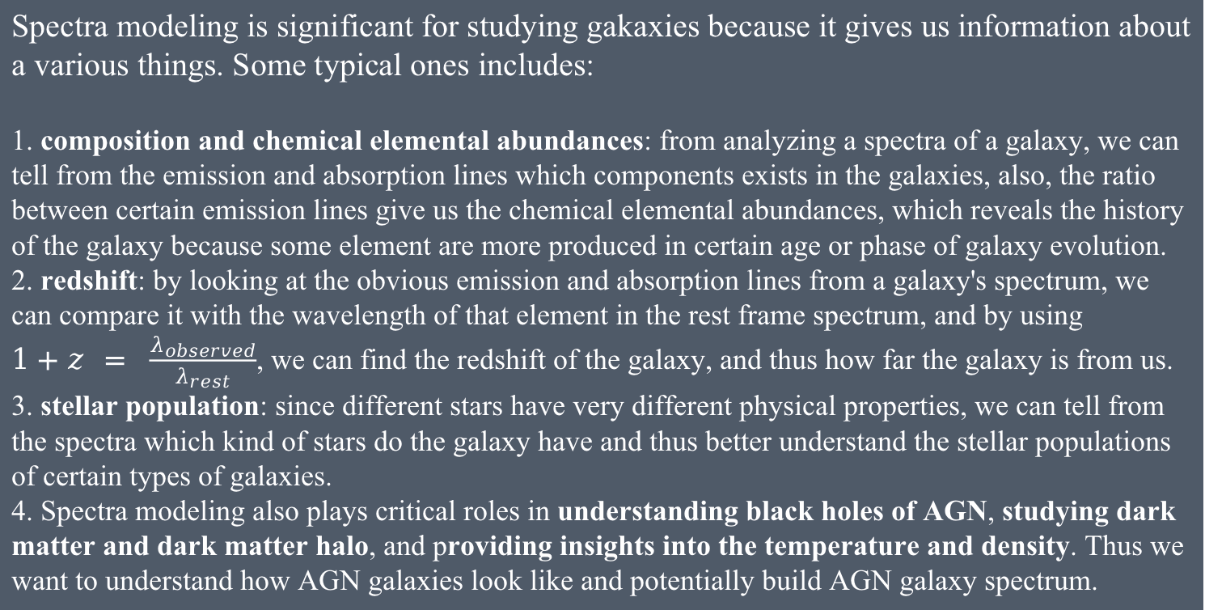
Optimization and Spectra Modeling
Spectra modeling is significant for studying gakaxies because it gives us information about a various things. Some typical ones includes:
1. composition and chemical elemental abundances: from analyzing a spectra of a galaxy, we can tell from the emission and absorption lines which components exists in the galaxies, also, the ratio between certain emission lines give us the chemical elemental abundances, which reveals the history of the galaxy because some element are more produced in certain age or phase of galaxy evolution.
2. redshift: by looking at the obvious emission and absorption lines from a galaxy's spectrum, we can compare it with the wavelength of that element in the rest frame spectrum, and by using $1+z = \frac{λ_{observed}}{λ_{rest}}$, we can find the redshift of the galaxy, and thus how far the galaxy is from us.
3. stellar population: since different stars have very different physical properties, we can tell from the spectra which kind of stars do the galaxy have and thus better understand the stellar populations of certain types of galaxies.
4. Spectra modeling also plays critical roles in understanding black holes of AGN, studying dark matter and dark matter halo, and providing insights into the temperature and density. Thus we want to understand how AGN galaxies look like and potentially build AGN galaxy spectrum.

Slide 14
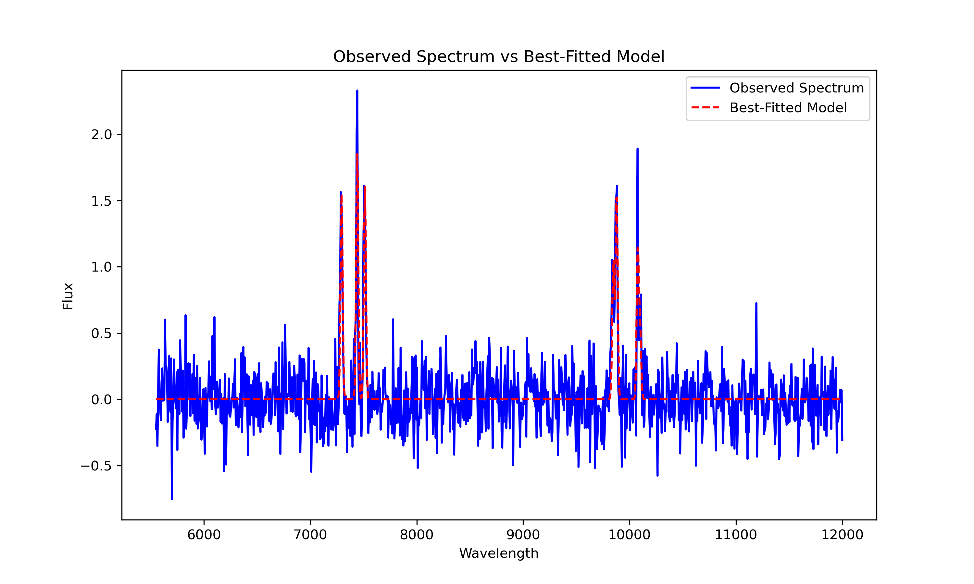
Optimization and Spectra Modeling
Best-fit Model. Input redshift: 0.5; model redshift: 0.5005. Error within 0.01 for all redshift up to 10

Slide 15
Optimization and Spectra Modeling
It also calculates the line intensity, which allow us to calculate the star formation rate and alpha abundance
By using the Galaxy class, I generated 1000 AGN galaxies in the redshift range [0.01, 1] with corresponding spectra.
Then I fit each of the spectra and find the intensity for emission lines.
I calculated the star formation rate and H-alpha/H-beta ratio for each of the galaxy...

Slide 16
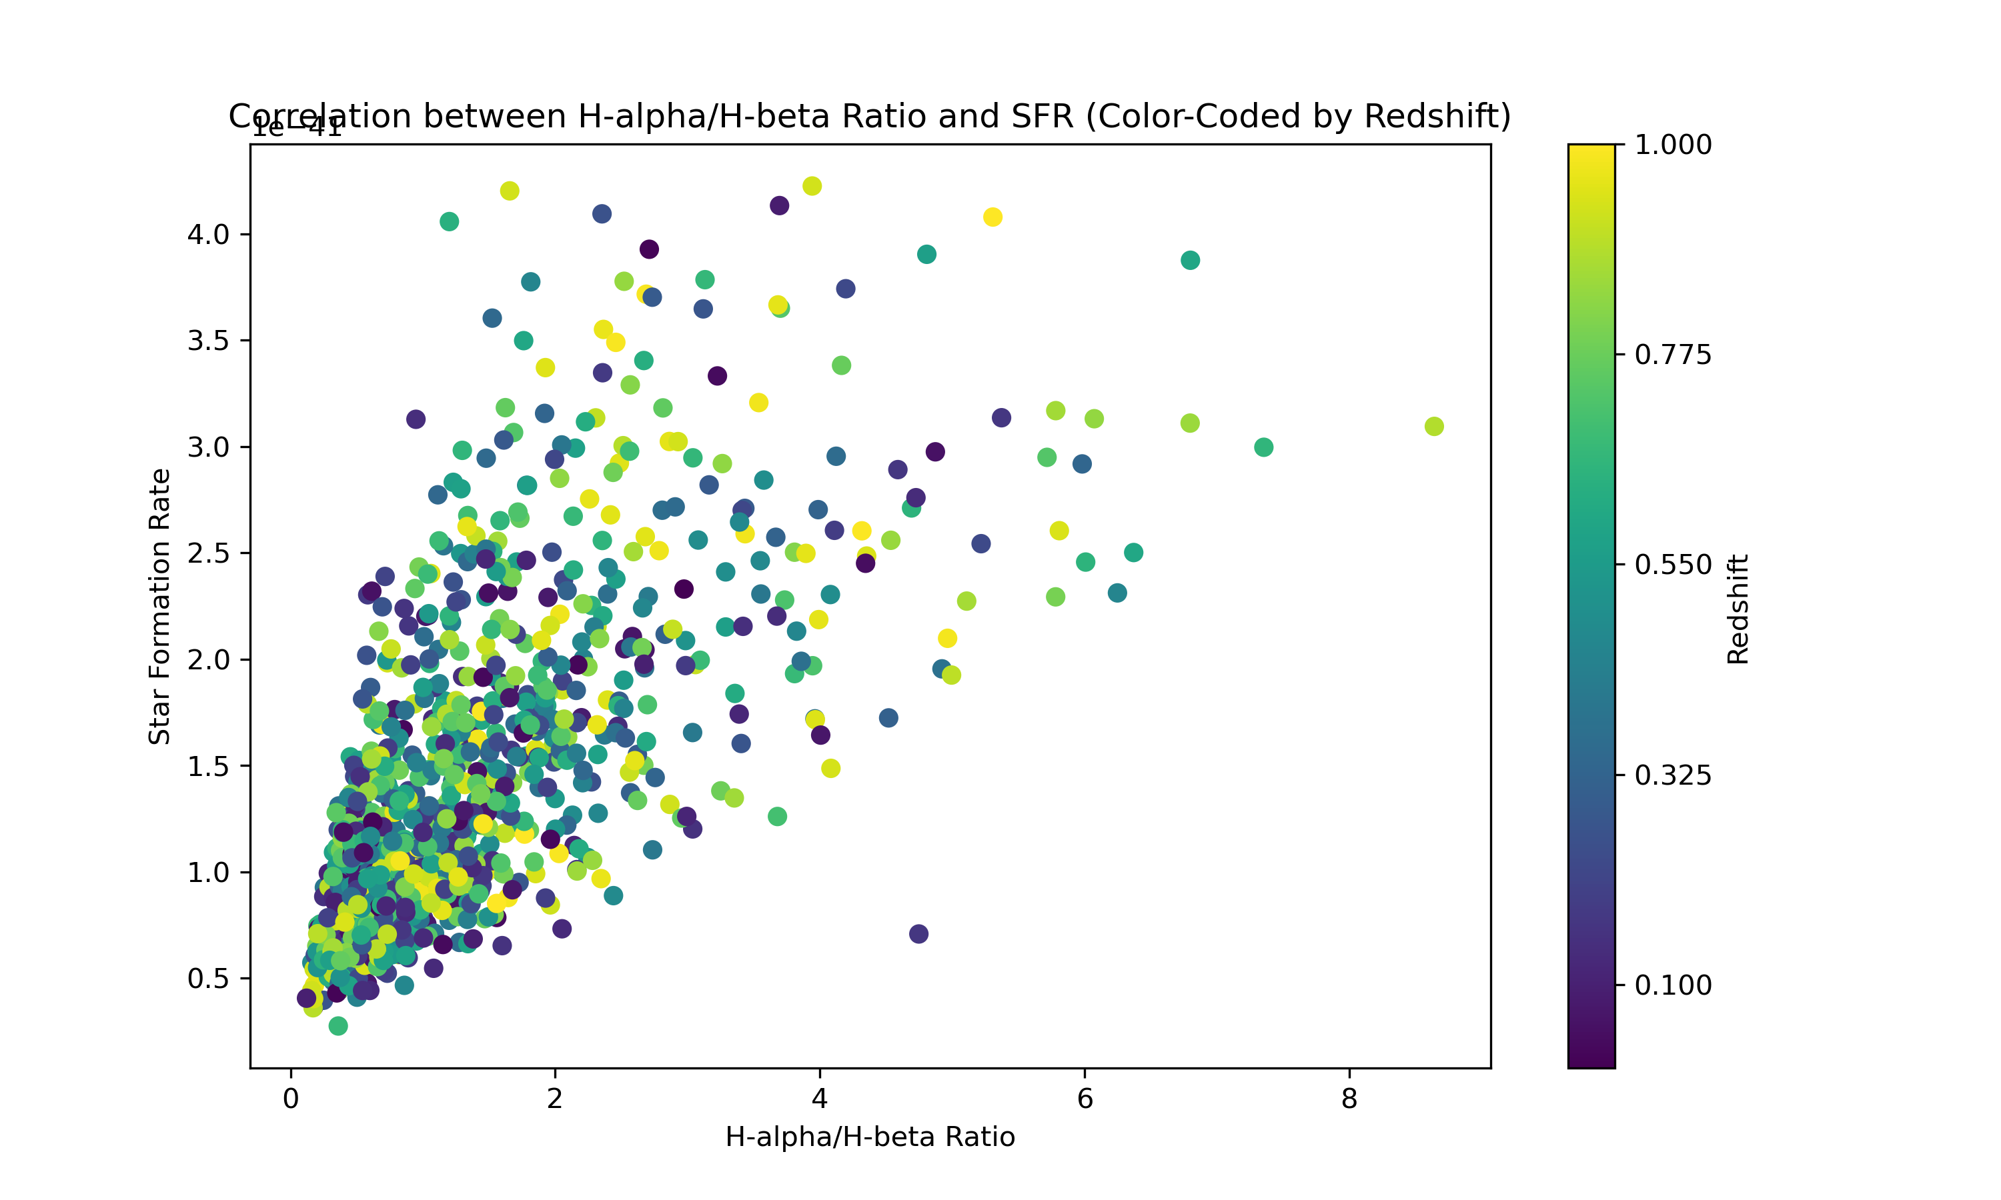
Optimization and Spectra Modeling
And Plotted them out!

Slide 17
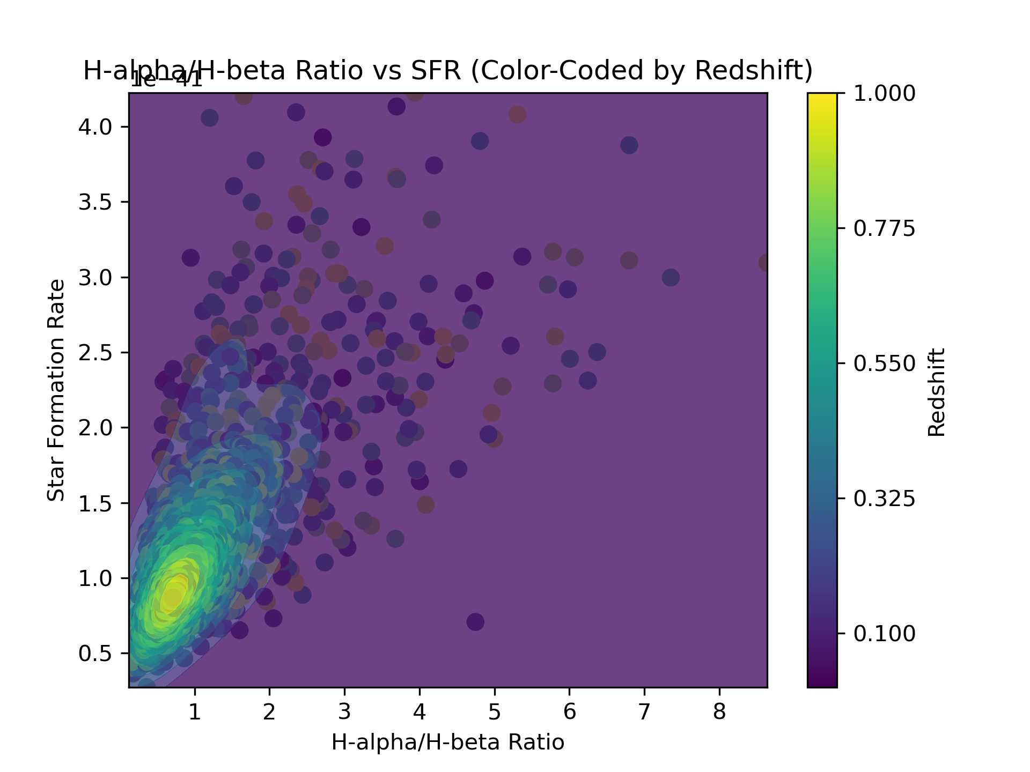
Optimization and Spectra Modeling
Contour plot: better visualize the density of data point for large sample
Most of the datapoints lies on low H-alpha/H-beta ratio and low star formation region
It has an overall trend that SFR increases as H-alpha/H-beta ratio increases.

Slide 18
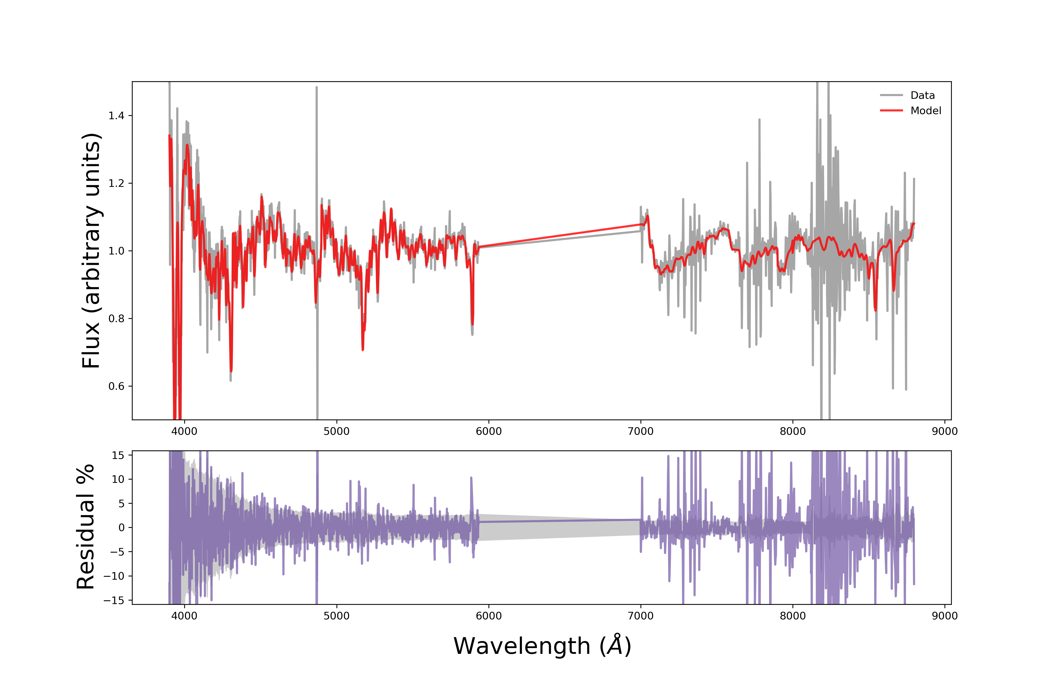
Relation to Physics and Implication
Finding the correlation between stellar population
Monte Carlo Simulation
ALF code by Conroy et al. 2012 and Conroy et al. 2018
Generate Parameters
Age (log(age))
Metallicity ([Z/H])
Alpha enhancement ([ɑ/Fe])
Chemical elemental abundance
Carbon, Nitrogen, Oxygen, Magnesium, Silicon, Calcium, Titanium, and Sodium.

Slide 19
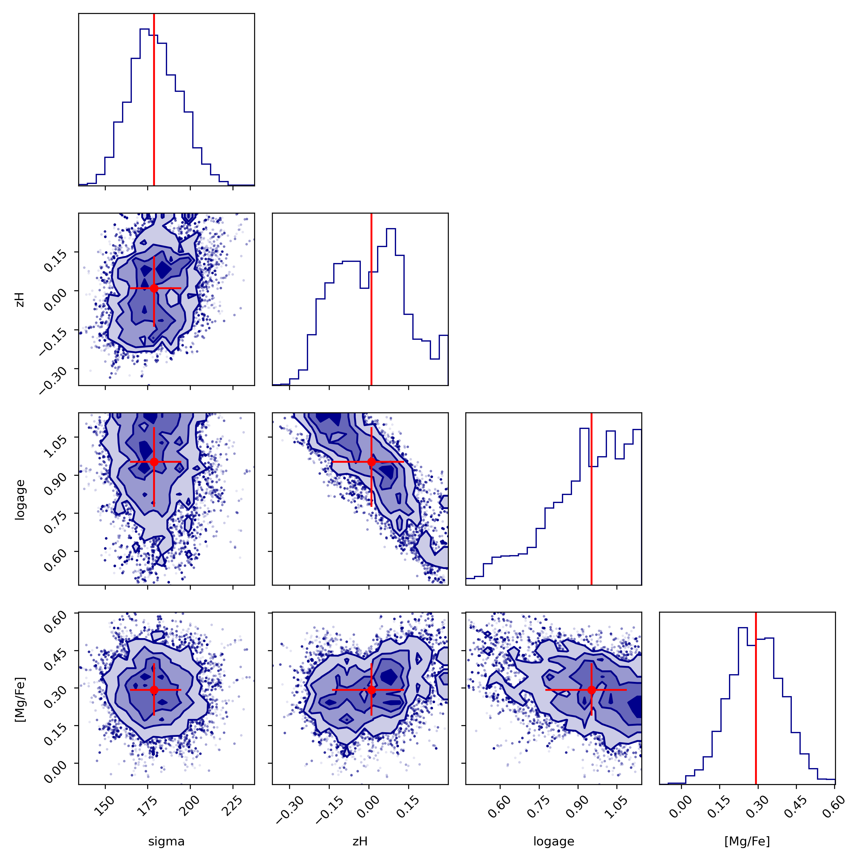
Relation to Physics and Implication
Monte Carlo Simulation
ALF code by Conroy et al. 2012 and Conroy et al. 2018
age (logage)
metallicity ([z/H])
velocity dispersion (sigma)
alpha enhancement ([Mg/Fe])

Slide 20
Relation with this course
Based on a subfield of physics
Used Python techniques such as defining a “Class”
Unix Skill: using unix command to run the ALF code
Computational Skill: Optimization, Monte Carlo Simulation, Pearson Correlation
Implicabable: spectra fitting example

Slide 21
Conclution
I have created a “Galaxy” Class that allows me to generate random AGN galaxy with accretion model, cooling/heating model, and spectra
The accretion rate is most closely related to black hole mass, it increases as black hole mass increases, same as radiation
As density increases, the heating rate increases, the cooling rate increases as well, and the overall temperature peaks lower and decays faster
Using optimization, I can fit the spectra and calculate redshift within an error 0.01
SFR increases as H-alpha/H-beta ratio increases
Using spectra modeling on real datasets, we can find the correlation between parameters

Slide 22
References
- Choi, J., Dotter, A., Conroy, C., Cantiello, M., Paxton, B., & Johnson, B. D. (2016). Mesa isochrones and Stellar Tracks (mist). I. Solar-scaled models. The Astrophysical Journal, 823(2), 102. https://doi.org/10.3847/0004-637x/823/2/102
- Conroy, C., Graves, G. J., & van Dokkum, P. G. (2013). Early-type Galaxy archeology: Ages, abundance ratios, and effective temperatures from full-spectrum fitting. The Astrophysical Journal, 780(1), 33. https://doi.org/10.1088/0004-637x/780/1/33
- Conroy, C., Villaume, A., Dokkum, P. G. van, Lind, K., https://orcid.org/0000-0002-1590-8551, C. C., https://orcid.org/0000-0003-1887-0621, A. V., & https://orcid.org/0000-0002-8282-9888, P. G. van D. (2018, February 21). IOPscience. The Astrophysical Journal. https://iopscience.iop.org/article/10.3847/1538-4357/aaab49
- Li, Y., Ruszkowski, M., & Bryan, G. L. (2016, November 16). AGN heating in simulated cool-core clusters. arXiv.org. https://arxiv.org/abs/1611.05455
- Panda, S. (2022, February 16). Parameterizing the AGN radius–luminosity relation from the eigenvector 1 viewpoint. Frontiers. https://www.frontiersin.org/articles/10.3389/fspas.2022.850409/full
- Sanchez-Blazquez, P., Peletier, R. F., Jimenez-Vicente, J., Cardiel, N., Cenarro, A. J., Falcon-Barroso, J., Gorgas, J., Selam, S., & Vazdekis, A. (2006). Medium-resolution Isaac Newton Telescope Library of empirical spectra. Monthly Notices of the Royal Astronomical Society, 371(2), 703–718. https://doi.org/10.1111/j.1365-2966.2006.10699.x
- Stone, J. M., & Norman, M. L. ZEUS-2D: A Radiation Magnetohydrodynamics Code for Astrophysical Flows in Two Space Dimensions. I. The Hydrodynamic Algorithms and Tests. 1992a, ApJS, 80, 753. 1992b, ApJS, 80, 791
- Tanner, R., & Weaver, K. (2022, January 20). Simulations of AGN driven galactic outflow morphology and content. arXiv.org. https://arxiv.org/abs/2201.08360

Slide 23
Conclution
I have created a “Galaxy” Class that allows me to generate random AGN galaxy with accretion model, cooling/heating model, and spectra
The accretion rate is most closely related to black hole mass, it increases as black hole mass increases, same as radiation
As density increases, the heating rate increases, the cooling rate increases as well, and the overall temperature peaks lower and decays faster
Using optimization, I can fit the spectra and calculate redshift within an error 0.01
SFR increases as H-alpha/H-beta ratio increases
Using spectra modeling on real datasets, we can find the correlation between parameters
Thank you for watching! Any Question?

